Slide 1
CSCI-4320/6340: Parallel Programming & Computing MPI Point-2-Point and Collective Operations
Prof. Chris Carothers
Computer Science Department
chrisc@cs.rpi.edu
www.mpich.org

Slide 2
Topic Overview
Review: Principles of Message-Passing Programming
MPI Point 2 Point Messages..
MPI Datatypes
MPI_Isend/MPI_Irecv
MPI_Testsome
MPI_Cancel
MPI_Finalize
Collective Operations

Slide 3
MPI Datatypes
MPI_BYTE – untyped byte of data
MPI_CHAR – 8 bit char
MPI_DOUBLE – 64 bit floating point
MPI_FLOAT – 32 bit floating point
MPI_INT – signed 32 bit integer
MPI_LONG – signed 32 bit integer
MPI_LONG_LONG – signed 64 bit integer
MPI_UNSIGNED_X – unsigned LONG, LONG LONG or SHRORT
MPI_UNSIGNED – unsigned 32 bit integer

Slide 4
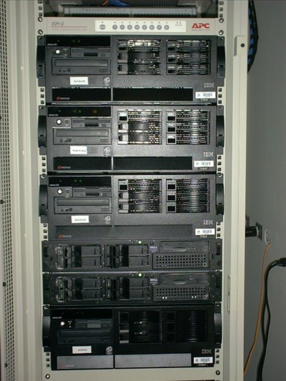
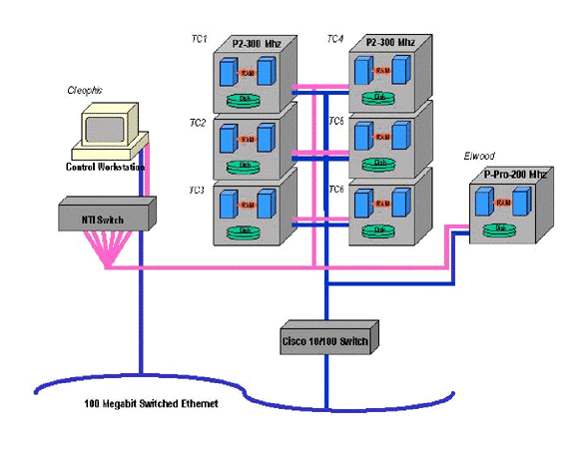
Review: Mental Model

Slide 5
Review: Principles of Message-Passing Programming
The logical view of a machine supporting the message-passing paradigm consists of p processes, each with its own exclusive address space.
Each data element must belong to one of the partitions of the space; hence, data must be explicitly partitioned and placed.
All interactions (read-only or read/write) require cooperation of two processes - the process that has the data and the process that wants to access the data.
These two constraints, while onerous, make underlying costs very explicit to the programmer.

Slide 6
Point-2-Point: MPI_Isend
MPI_Isend only “copies” the buffer to MPI and returns.
Isend only completes when request status indicates so
Is non-blocking
int MPI_Isend(void *buf, int count, MPI_Datatype datatype,
int dest, int tag, MPI_Comm comm,
MPI_Request *request)
Inputs:
buf – initial address of buffer being sent.
count – number of elements in send buffer
datatype – datatype of each send buffer element
dest – rank of destination
tag – message tag
comm – communicator handle
Outputs:
request – request handle used to check status of send.

Slide 7
Point-2-Point: MPI_Irecv
MPI_Irecv only “posts” a receive to the MPI layer and returns.
Irecv is complete when request status indicates so.
Is non-blocking and will help to avoid deadlock.
int MPI_Irecv(void *buf, int count, MPI_Datatype datatype,
int source, int tag, MPI_Comm comm,
MPI_Request *request)
Inputs:
buf – initial address of buffer being sent.
count – number of elements in send buffer
datatype – datatype of each send buffer element
dest – rank of destination
tag – message tag
comm – communicator handle
Outputs:
request – request handle used to check status of send.

Slide 8
Point-2-Point: MPI_Testsome
MPI_Testsome allows you to test the success of posted send and recv requests.
Is non-blocking.
int MPI_Testsome(int incount, MPI_Request array_of_requests[],
int *outcount, int array_of_indices,
MPI_Status array_of_statuses)
Inputs:
incount – length of array_of_requests
array_of_requests – array of request handles
Outputs:
outcount – number of completed requests
array_of_indices – array of indices that completed
array_of_statuses – array of status objects for operations that completed
Other functions are MPI_Testall

Slide 9
Point-2-Point: MPI_Iprobe
Non-blocking test for a message w/o actually have to receive that message.
Can be an expensive operation on some MPI Isend Irecv & Collectives.
E.g., Iprobe followed by Irecv.
int MPI_Iprobe(int source, int tag, MPI_Comm comm,
int *flag,
MPI_Status *status)
Inputs
source – source rand or MPI_ANY_SOURCE
tag – tag value or MPI_ANY_TAG
comm – communicator handle

Slide 10
Point-2-Point: MPI_Cancel
Enables the cancellation of a pending request, either sending or receiving.
Most commonly used for Irecvs.
Can be used for Isends but can be very expensive.
int MPI_Cancel(MPI_Request *requests);

Slide 11
Collective Communication and Computation Operations
MPI provides an extensive set of functions for performing common collective communication operations.
Each of these operations is defined over a group corresponding to the communicator.
All processors in a communicator must call these operations.
If not, deadlock will happen!!

Slide 12
Collective Communication Operations
The barrier synchronization operation is performed in MPI using:
int MPI_Barrier(MPI_Comm comm)
The one-to-all broadcast operation is:
int MPI_Bcast(void *buf, int count,
MPI_Datatype datatype,
int source, MPI_Comm comm)
The all-to-one reduction operation is:
int MPI_Reduce(void *sendbuf, void *recvbuf, int count, MPI_Datatype datatype, MPI_Op op, int target, MPI_Comm comm)

Slide 13
Predefined Reduction Operations
Operation | Meaning | Datatypes
MPI_MAX | Maximum | C integers and floating point
MPI_MIN | Minimum | C integers and floating point
MPI_SUM | Sum | C integers and floating point
MPI_PROD | Product | C integers and floating point
MPI_LAND | Logical AND | C integers
MPI_BAND | Bit-wise AND | C integers and byte
MPI_LOR | Logical OR | C integers
MPI_BOR | Bit-wise OR | C integers and byte
MPI_LXOR | Logical XOR | C integers
MPI_BXOR | Bit-wise XOR | C integers and byte
MPI_MAXLOC | max-min value-location | Data-pairs
MPI_MINLOC | min-min value-location | Data-pairs

Slide 14
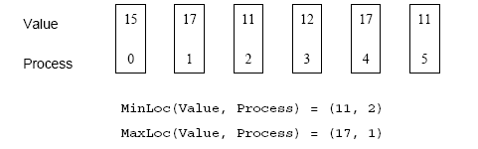
Collective Communication Operations
The operation MPI_MAXLOC combines pairs of values (v_{i}, l_{i}) and returns the pair (v, l) such that v is the maximum among all v_{i} 's and l is the corresponding l_{i} (if there are more than one, it is the smallest among all these l_{i} 's).
MPI_MINLOC does the same, except for minimum value of v_{i}.

Slide 15
Collective Communication Operations
MPI datatypes for data-pairs used with the MPI_MAXLOC and MPI_MINLOC reduction operations.
MPI Datatype | C Datatype
MPI_2INT | pair of ints
MPI_SHORT_INT | short and int
MPI_LONG_INT | long and int
MPI_LONG_DOUBLE_INT | long double and int
MPI_FLOAT_INT | float and int
MPI_DOUBLE_INT | double and int

Slide 16
Collective Communication Operations
If the result of the reduction operation is needed by all processes, MPI provides:
int MPI_Allreduce(void *sendbuf, void *recvbuf,
int count, MPI_Datatype datatype, MPI_Op op, MPI_Comm comm)
To compute prefix-sums, MPI provides:
int MPI_Scan(void *sendbuf, void *recvbuf, int count, MPI_Datatype datatype, MPI_Op op, MPI_Comm comm)
e.g <3,1,4,0,2> ➔ <3,4,8,8,10>

Slide 17
Collective Communication Operations
The gather operation is performed in MPI using:
int MPI_Gather(void *sendbuf, int sendcount,
MPI_Datatype senddatatype, void *recvbuf,
int recvcount, MPI_Datatype recvdatatype,
int target, MPI_Comm comm)
MPI also provides the MPI_Allgather function in which the data are gathered at all the processes.
int MPI_Allgather(void *sendbuf, int sendcount, MPI_Datatype senddatatype, void *recvbuf,
int recvcount, MPI_Datatype recvdatatype,
MPI_Comm comm)
The corresponding scatter operation is:
int MPI_Scatter(void *sendbuf, int sendcount,
MPI_Datatype senddatatype, void *recvbuf,
int recvcount, MPI_Datatype recvdatatype,
int source, MPI_Comm comm)

Slide 18
Collective Communication Operations
The all-to-all personalized communication operation is performed by:
int MPI_Alltoall(void *sendbuf, int sendcount, MPI_Datatype senddatatype,
void *recvbuf,
int recvcount,
MPI_Datatype recvdatatype, MPI_Comm comm)
Using this core set of collective operations, a number of programs can be greatly simplified.

